Slide 1
UNIT THREE
Data Modeling :
Using the Entity-Relationship (ER)

Slide 2
Chapter Outline
Example Database Application (COMPANY)
ER Model Concepts
Entities and Attributes
Entity Types, Value Sets, and Key Attributes
Relationships and Relationship Types
Weak Entity Types
ER Diagrams - Notation
Extended ER Diagram

Slide 3
3.1 Requirements Analysis
A database is intended to model a real world enterprise
What data are to be stored in the database?
Linguistic aside: data is plural, datum is singular
What applications are required to work with the database?
Which are the most frequent, and the most important operations?

Slide 4
3.2 Conceptual Database Design----
Construct the organizational and user data requirements discovered and analyzed during requirement analysis.
It is the process of constructing a model of the information used in an enterprise.
Conceptual database design is used as input or source of information for the logical database design phase.
It is a database design phase which is independent of all physical considerations (DBMS, OS, . . . ).
Use the Entity Relationship (ER) model to develop a high level description of the data (conceptual level, conceptual schema).

Slide 5
3.2 Conceptual Database Design----
The conceptual design activities are:
Identify the entities and relationships in the enterprise
Identify what information(attributes) about these entities and relationships is to be stored in the database
Identify the integrity constraints (business rules) that apply to the entities and relationships

Slide 6
3.2 Conceptual Database Design-----
Questions that are addressed during conceptual design:
What are the entities and relationships of interest?
What information about entities and relationships among entities needs to be stored in the database?
What are the constraints (or business rules) that (must) hold for the entities and relationships?
A database schema in the ER model can be represented pictorially using (Entity-Relationship diagram).

Slide 7
3.3 Reasons of Conceptual Modeling
Because conceptual modeling has the following advantages:
Helps users and system developers to identify data requirements (abstract model)
Helps in understanding how existing systems can be modified/maintained
Allows for easy communication between end-users and developers.
It is independent of DBMS or any OS.
It has a clear method to convert from high-level model to relational model.
It is a permanent description of the database requirements.

Slide 8
3.4 Entity-Relationship Model
The most common abstract data model
It is an abstract and conceptual representation of data.
It is used to produce a type of conceptual schema of a system.
ER model is used to interpret, specify & document requirements for DBs irrespective of DBMS being used.
The diagram used to model the data requirements of the organization or user is ER diagram
E-R diagrams provide a visual, graphical model of the information content of a system.

Slide 9
3.4 Entity-Relationship Model-------
Entity-relationship diagrams show the structure of a database graphically
Relationships that connect the entities,
Example:
CUSTOMER owns ACCOUNT
STUDENT takes COURSE
Simple symbols used in ER diagram:
rectangles,
diamonds,
ovals and lines represent the components of the ER model
ER diagrams are straightforward and easy to explain to users

Slide 10
3.5 Building Blocks of ER Model
1. Entity
It is real world physical or logical object with an independent existence and which is distinguishable from other objects.
It is represented in the ERD by a rectangle, also known as an entity box.
The name of the entity is , a noun, and written in the center of the rectangle.
Entity name is written in capital letters and is written in the singular form:
PAINTER rather than PAINTERS, and EMPLOYEE rather than EMPLOYEES.
Usually, when applying the ERD to the relational model, an entity is mapped to a relational table.

Slide 11
3.5 Components of ER Model------
Each row in the relational table is known as an entity instance or entity occurrence in the ER model.
Each entity is described by a set of attributes that describes particular characteristics of the entity.
For example, the entity EMPLOYEE will have attributes such as a Social Security number, a last name, and a first name.
Examples of Entities
Persons: agency, contractor, customer, department, division, employee, instructor, student, supplier.

Slide 12
3.5 Components of ER Model------
Places: sales region, building, room, branch office, campus.
Objects: book, machine, part, product, raw material, software license, software package, tool, vehicle model, vehicle.
Events: application, award, cancellation, class, flight, invoice, order, registration, renewal, requisition, reservation, sale, trip.
2. Attributes
Attributes are properties used to describe each entity or real world object.
That are used to store pieces of information about entities.
Attributes will give rise to recorded items of data in the database

Slide 13
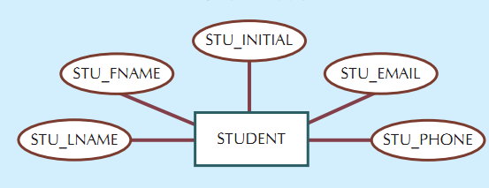
3.5 Components of ER Model------
For example, the STUDENT entity includes, among many others, the attributes STU_LNAME, STU_FNAME, and STU_INITIAL.
In the original Chen notation, attributes are represented by ovals and are connected to the entity rectangle with a line.
Figure 3.1 The attributes of the STUDENT entity: Chen Model

Slide 14
3.5.1 Types of Attributes
1. Required and Optional Attribute
A required attribute is an attribute that must have a value; in other words, it cannot be left empty.
Figure 3.1 in the previous slide shows, there are two attributes for example, STU_LNAME and STU_FNAME require data entries because of the assumption that all students have a last name and a first name.
But students might not have a middle name, and perhaps they do not (yet) have a phone number and an e-mail address.
Therefore, those attributes may not require to enter data.
An optional attribute is an attribute that does not require a value; therefore, it can be left empty.

Slide 15
3.5.1 Types of Attributes------
2. Composite and Simple Attributes
A composite attribute, is an attribute that can be further subdivided to yield additional attributes.
For example, the attribute Address can be subdivided into street_Address, city, state, and Postal_code.
Similarly, the attribute Phone_Number can be subdivided into area_code and exchange number.
A simple attribute is an attribute that cannot be subdivided.
For example, age, sex, and marital_status would be classified as simple attributes.

Slide 16
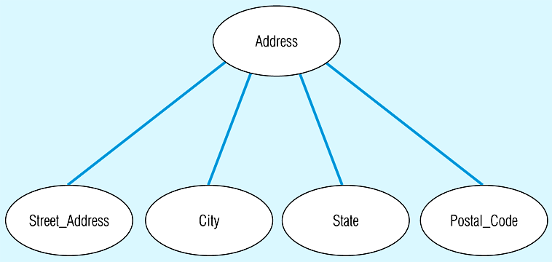
3.5.1 Types of Attributes------
To facilitate detailed queries, it is wise to change composite attributes into a series of simple attributes.
The following figure shows an attribute broken into component parts
Figure 3.2 A composite attribute

Slide 17
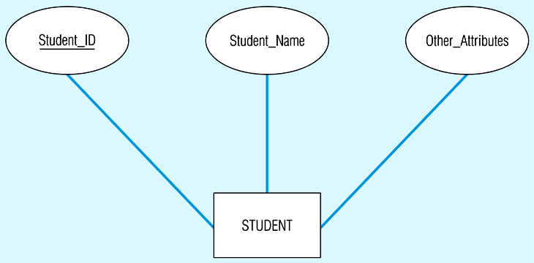
3.5.1 Types of Attributes------
3. Identifiers (Primary Keys) Attribute
Identifier or primary Key attribute is an attribute (or combination of attributes) that uniquely identifies individual instances of an entity type, such as Student_ID.
Identifiers are underlined in the ERD.
Identifier can be simple or composite identifier
(a) Simple key attribute

Slide 18
3.5.1 Types of Attributes------
Ideally, an entity identifier is composed of only a single attribute.
However, it is possible to use a composite identifier, that is, a primary key composed of more than one attribute.
A Composite Identifier is when there is no single (or atomic) that can serve as an identifier
Flight_ID is a composite identifier that has component attributes Flight_Number and Date– this combination is required to uniquely identify individual occurrences of Flight.
Flight_ID is underlined, while its components are not .

Slide 19
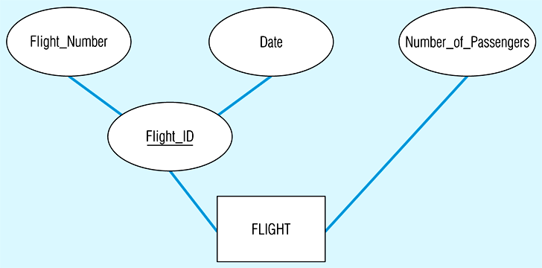
3.5.1 Types of Attributes------
If the Flight_ID attribute is deleted from FLIGHT entity, the candidate keys (Flight_Number and Date) becomes an acceptable composite primary key.
The following figure shows a primary key composed of more than one attribute.
(b) Composite key attribute

Slide 20
3.5.1 Types of Attributes------
4. Single versus Multivalued Attributes
A single-valued attribute is an attribute that can have only a single value.
For example, a person can have only one Social Security number, and a manufactured part can have only one serial number.
Keep in mind that a single-valued attribute is not necessarily a simple attribute.
For instance, a part’s serial number, such as SE-08-02-189935, is single-valued, but it is a composite attribute because it can be subdivided into the region in which the part was produced (SE), the plant within that region (08), the shift within the plant (02), and the part number (189935).

Slide 21
3.5.1 Types of Attributes------
Multivalued attributes are attributes that can have many values.
For instance, a person may have several college degrees, and a household may have several different phones, each with its own number.
Similarly, a car’s color may be subdivided into many colors (that is, colors for the roof, body, and trim).
In the Chen ERM, the multivalued attributes are shown by a double line connecting the attribute to the entity.
For example, the figure in the next slide, (Figure 3.3), note that CAR_VIN is the primary key, and CAR_COLOR is a multivalued attribute of the CAR entity.

Slide 22
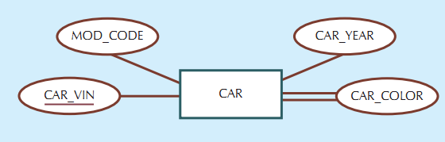
3.5.1 Types of Attributes------
The following example in the next slide in Figure 3.4 shows Entity with a multivalued attribute (Skill) and derived attribute (Years_Employed)
Figure 3. 3 A multivalued attribute in an entity

Slide 23
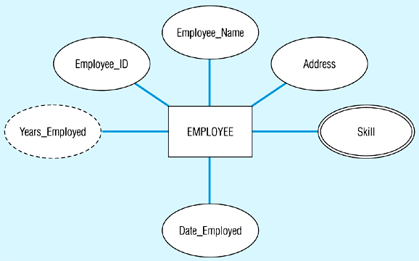
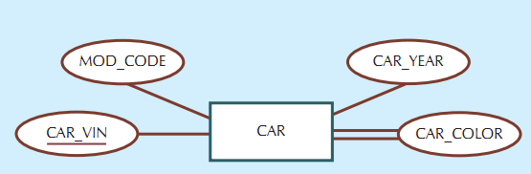
Figure 3. 4 Entity with a multivalued attribute (Skill) and derived attribute (Years_Employed)

Slide 24
3.5.1 Types of Attributes------
5. Derived versus Stored Attributes
A derived attribute is an attribute whose value is calculated (derived) from other attributes.
Derived attributes are sometimes referred to as computed attributes.
The derived attribute need not be physically stored within the database; instead, it can be derived by using an algorithm.
It is used to save storage space because computation always yields current value.
But the derived attributes have its own disadvantages such as:
uses CPU processing cycles,

Slide 25
3.5.1 Types of Attributes------
increases data access time and
adds coding complexity to queries.
The attribute of an employee for example, Age called a derived attribute and is said to be derivable from the BirthDate attribute, which is called a stored attribute.
Stored attribute- is an attribute in which the value is stored in the attribute of the entity.
For example, Birthdates is called a Stored attribute.
The stored attribute on the other hand, can have the following advantages:
saves CPU processing cycles,

Slide 26
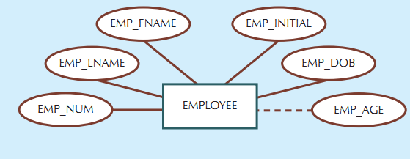
3.5.1 Types of Attributes------
saves data access time, data value is readily available and
It can be used to keep track of historical data
However, stored attributes has disadvantages such as:
requires constant maintenance to ensure derived value is current, especially if any values used in the calculation change.
Fig 3.5 Depiction of a derived attribute

Slide 27
3. RELATIONSHIPS
Relationship (relationship type) is a meaningful association among entity types.
Generally, a relationship is represented as a connection between (or among) entities.
In standard ER model, it uses a diamond shape to connect between (or among) entities.
The relationship name is an active or passive verb.
For example:
A STUDENT takes a CLASS,
A PROFESSOR teaches a CLASS,

Slide 28
3. RELATIONSHIPS------
A DEPARTMENT employs a PROFESSOR,
A DIVISION is managed by an EMPLOYEE.
There are several type of relationships based on the degree, cardinality, and participation.
The entities that participate in a relationship are also known as participants, and each relationship is identified by a name that describes the relationship.
The relationship classification is difficult to establish if you know only one side of the relationship.
For example, if you specify that:
A DIVISION is managed by one EMPLOYEE.

Slide 29
3. RELATIONSHIPS------
You don’t know if the relationship is 1:1 or 1:N.
Therefore, you should ask the question:
“Can an employee manage more than one division?”.
If the answer is yes, the relationship is 1:N, and
the second part of the relationship is then written as:
An EMPLOYEE may manage many DIVISIONs.
If an employee cannot manage more than one division,
the relationship is 1:1, and
the second part of the relationship is then written as:
An EMPLOYEE may manage only one DIVISION.

Slide 30
3.1 Connectivity of a Relationship
The connectivity of a relationship describes the mapping of associated entity instances (records) in the relationship.
The values of connectivity are "one" or "many".
The basic types of connectivity for relations are:
One-to-One (1:1)
One-to-Many (1:N)
Many-to-Many (M:N)
One-to-One (1:1)
An entity in A associates with at most one instance of entity in B, an entity in B associates with at most one instance of entity in A

Slide 31
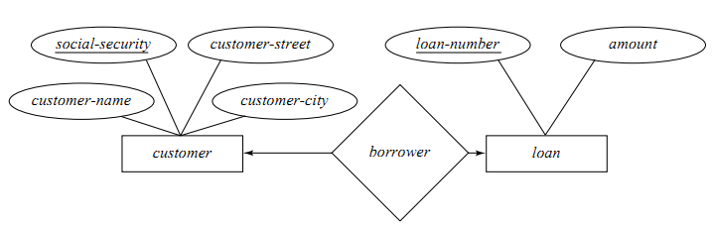
A customer is associated with at most one loan via the relationship borrower.
A loan is associated with at most one customer via borrower

Slide 32
3.1 Connectivity of a Relationship--------
2. One-to-many (1:N)
It is when for one instance of entity A, associated with zero, one, or many instances of entity B, but for one instance of entity B, there is only one instance of entity A.
An example of a 1:N relationships is a DEPARTMENT has many EMPLOYEE and each EMPLOYEE is assigned to one DEPARTMENT.
In a 1:N relationship, an entity on one side of the relationship can have many related entities,
but an entity on the other side will have a maximum of one related entity.

Slide 33
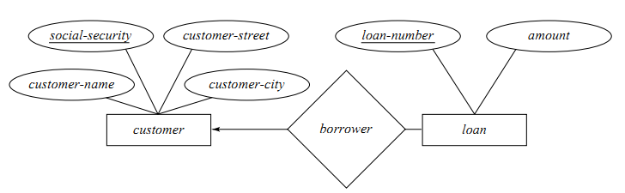
In the one-to-many relationship:
A customer is associated with several (including 0) loans via borrower
A loan is associated with at most one customer via borrower

Slide 34
3.1 Connectivity of a Relationship--------
3. Many-to-many (M:N)
This is when for one instance of entity A, there are zero, one, or many instances of entity B and for one instance of entity B there are zero, one, or many instances of entity A.
For Example:
EMPLOYEE can be assigned to no more than two PROJECTS at the same time.
PROJECT must have assigned at least three EMPLOYEE.
In this example; a single employee can be assigned to many projects; conversely, a single project can have assigned to it many employee.
Here the cardinality for the relationship between EMPLOYEE and PROJECT is two and the cardinality between PROJECT and EMPLOYEE is three.

Slide 35
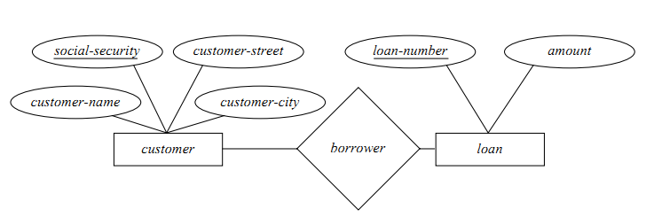
Many-to-many relationships cannot be directly translated to relational tables but instead must be transformed into two or more one-to-many relationships using associative entities.
A CUSTOMER is associated with several (possibly 0) LOAN via borrower
A LOAN is associated with several (possibly 0) CUSTOMER via borrower

Slide 36
3.2 Cardinality
The cardinality of a relationship is the actual number of related occurrences for each of the two entities.
Cardinality expresses the minimum and maximum number of entity occurrences associated with one occurrence of the related entity.
In the ERD, cardinality is indicated by placing the appropriate numbers beside the entities, using the format (x,y).
The first value (x), represents the minimum number of associated entities, while the second value (y) represents the maximum number of associated entities.
Cardinality express the number of entities to which another entity can be associated via a relationship set.
Mostly useful in describing binary relationship sets.

Slide 37
3.2 Cardinality-------
We express cardinality constraints by drawing either a directed line (→), signifying “one,” or an undirected line (—), signifying “many,” between the relationship set and the entity set.
Keep in mind that the cardinalities represent the number of occurrences in the related entity.
For example:
The cardinality (1,4) written next to the CLASS entity in the “PROFESSOR teaches CLASS” relationship indicates that
Each PROFESSOR teaches up to four classes, which means that the PROFESSOR table’s primary key value occurs at least once and no more than four times as foreign key values in the CLASS table.

Slide 38
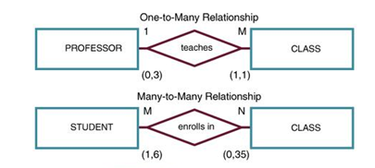
3.2 Cardinality-------
If the cardinality had been written as (1,N), there would be no upper limit to the number of classes a professor might teach.
Similarly, the cardinality (1,1) written next to the PROFESSOR entity indicates that each CLASS is taught by one and only one PROFESSOR.
That is, each CLASS entity occurrence is associated with one and only one entity occurrence in PROFESSOR.
Figure 3.10. Cardinality in ERD

Slide 39
Activity 1
1. Read the following three business problems and build ER diagram.
A student record management system will have the following two basic data object categories with their own features or properties: Students will have an Id, Name, Dept, Age, GPA and Course will have an Id, Name, Credit Hours. Whenever a student enroll in a course in a specific Academic Year and Semester, the Student will have a grade for the course
A Personnel record management system will have the following two basic data object categories with their own features or properties: Employee will have an Id, Name, DoB, Tel. Department will have an Id, Name, Location. Whenever an Employee is assigned in one Department, the duration of his stay in the respective department should be registered.

Slide 40
Activity 1
C. A company database needs to store information about employees (identifyied by ssn, with salary and phone as attributes); departments (identified by dno, with dname and budget as attributes); and children of employees (with name and age as attributes). Employees work in departments; each department is managed by an employee; a child must be identified uniquely by name when the parent (who is an employee; assume that only one parent works for the company) is known. We are not interested in information about a child once the parent leaves the company.
Based on this business scenario in C, identify, entities, attributes of each entity and the relation ship between entities. Draw ER diagram and shows the cardinality between entities.

Slide 41
3.3 Relationship Participation
Participation in an entity relationship is either optional (partial participation) or mandatory (total participation).
Recall that relationships are bidirectional; that is, they operate in both directions.
If COURSE is related to CLASS, then by definition, CLASS is related to COURSE.
Because of the bidirectional nature of relationships, it is necessary to determine the,
connectivity of the relationship from COURSE to CLASS and the
connectivity of the relationship from CLASS to COURSE.
Similarly, the specific maximum and minimum cardinalities must be determined in each direction for the relationship.
Once again, you must consider the bidirectional nature of the relationship when determining participation.

Slide 42
3.3 Relationship Participation--------
1. Optional (Partial) participation
One entity occurrence does not require a corresponding entity occurrence in a particular relationship.
For example, in the “COURSE generates CLASS” relationship, you noted that at least some courses do not generate a class.
In other words, an entity occurrence in the COURSE table does not necessarily require the existence of a corresponding entity occurrence in the CLASS table.
Remember that each entity is implemented as a table.
Therefore, the CLASS entity is considered to be optional to the COURSE entity.
The existence of an optional entity indicates that the minimum cardinality is 0 for the optional entity.

Slide 43
3.3 Relationship Participation--------
The term optionality is used to label any condition in which one or more optional relationships exist.
2. Mandatory Participation
This means that one entity occurrence requires a corresponding entity occurrence in a particular relationship.
The existence of a mandatory relationship indicates that the minimum cardinality is at least 1 for the mandatory entity.
Let’s examine a few more scenarios.
Suppose that Unity University employs some professors who conduct research without teaching classes.
If you examine the “PROFESSOR teaches CLASS” relationship, it is quite possible for a PROFESSOR not to teach a CLASS.

Slide 44
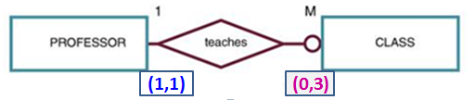
3.3 Relationship Participation--------
Therefore, CLASS is optional to PROFESSOR.
On the other hand, if the University is forced to teach MBA(Masters) CLASS according to the requirement of higher education profile, a CLASS must be taught by a PROFESSOR.
Therefore, PROFESSOR is mandatory to CLASS.
Note that the ERD model in the figure below, shows:
The cardinality next to CLASS to be (0,3), thus indicating that a PROFESSOR may teach no CLASSE at all or as many as three classes.
And each CLASS table row will reference one and only one PROFESSOR row—assuming each CLASS is taught by one and only one professor—represented by the (1,1) cardinality next to the PROFESSOR table.

Slide 45
3.4 Relationship Degree
Degree of a relationship: refers to the number of entity types that participate in the relationship type (unary, binary, ternary).
Unary Relationships
A unary relationship exists when an association is maintained within a single entity.
B) Binary Relationships
A binary relationship exists when two entities are associated in a relationship. Binary relationships are most common.
C) Ternary Relationships
A ternary relationship implies an association among three different entities.

Slide 46
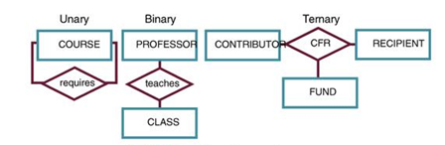
3.4 Relationship Degree--------
Figure 3. Degree of Relationships

Slide 47
3.5. Recursive Relationships
A recursive entity is one in which a relationship can exist between occurrences of the same entity set.
A recursive entity is found within a unary relationship.
A relationship type with the same participating entity type in distinct roles
Example: the SUPERVISION relationship
EMPLOYEE participates twice in two distinct roles:
supervisor (or boss) role
supervisee (or subordinate) role
Each relationship instance relates two distinct EMPLOYEE entities:
One employee in supervisor role
One employee in supervisee role
Another Example, a COURSE may be a prerequisite to a COURSE.

Slide 48
3.6 Entity Sets and Entity
Entity Set is a collection or a group of ‘entities’ sharing exactly the ‘same set of attributes’.
All entities can be distinctly identified in an entity set.
This is because all the entities have a different set of value for some set of attributes.
The collection of entity sets and their relationship sets together forms a database.
An entity is an ‘object’ in the ‘actual world’, and that can be identified from the other objects.
Here, a question arises that how an entity is different from other entity?
For this, we need to know how an entity is expressed.

Slide 49
Entity Sets and Entity -----
An entity in a database is represented as a set of attributes.
Each entity has a different set of values for some set of attributes and this is how an entity seems to be distinct from other entities.
In a relational model, an entity is represented as a row, tuple or a record.
For example, consider a group of students is there, each student in the group is a separate entity.
Now, how we can identify a particular student in that group? Simple, each student will have a different name, roll number, or course etc.
If you call for a student among a group no one will come until you specify either his name or another distinguishable attribute.

Slide 50
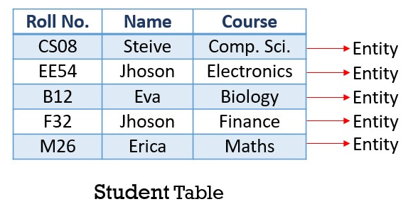
Entity Sets and Entity -----
Observe the table below, suppose we have an entity set Student, which is represented by Student Table in the relational model.
The entries in the Student table are the entities.
Student Steive with roll number CS08 and Course Comp. Sci. is a particular entity as is distinguishable among all the students in the table.
Likewise, all the students in the Student Table can be uniquely identified from other students. So, each student in the table is an entity.

Slide 51
Entity Sets and Entity -----
What is Entity Set?
An entity set is a group of entities that posses the same set of attributes.
Each entity in an entity set has its own set of values for the attributes which make it distinct from other entities in a table.
No two entities in an entity set will have the same values for the attributes.
In a database, an entity set is represented by the Table.
The table in the next slide shows that, you can see the Student Table which as multiple entries i.e. entity.
Now, observe that the two students have the name Jhoson but, still they are uniquely identified as both posses different roll number.

Slide 52
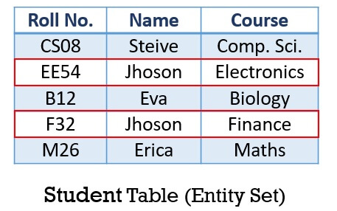
Entity Sets and Entity -----

Slide 53
Types of Entity Set
Strong Entity Set
Weak Entity Set
1. Strong Entity Set
An entity set that has a primary key using which, entities in the table can be uniquely identified.
This kind of entity set is termed as a strong entity set.
Strong entity set is also known as a regular entity set.
In an ER diagram, the strong entity set is represented by the rectangle.
Here, the primary key is underlined with the solid line.

Slide 54
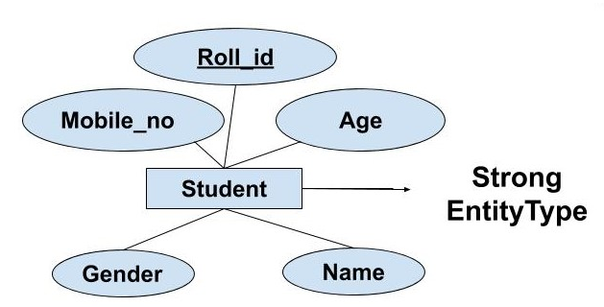
1. Strong Entity Set------
In the following ER-diagram below, Roll_Id identifies each element of the table uniquely and hence, we can say that STUDENT is a strong entity type

Slide 55
2. Weak Entity Sets
A weak entity set doesn’t have any primary key which can identify each entity in a set distinctly.
But, for discriminating the entities in a set, the weak entity set is dependent on a particular strong entity set.
A weak entity is also said to be existence dependent as for the existence of its entities it has to be dependent on identifying entity set i.e. a particular ‘strong entity set’.
The relation between a weak entity set and a strong entity set is said to be identifying relationship

Slide 56
2. Weak Entity Sets-------
The relation within a weak entity set to a strong entity set is a many-to-one relationship.
So, many weak entity sets can be related to one particular strong entity set .
Now, a weak entity set has a discriminator (or partial key) which is a ‘set of attributes’ that help in distinguishing the entities.
The weak entity gets its primary key combining the partial key of the ‘weak entity’ plus the primary key of identifying ‘strong entity set’.
Let us understand this with an example, we have an entity set SECTION and COURSE.
The SECTION has attributes {Sec-id, year, semester}.

Slide 57
2. Weak Entity Sets-------
Now, there can’t be a SECTION without any COURSE.
So, it has to be dependent on the COURSE entity set for its existence.
On the other hand, for the different COURSES, the attributes of SECTION entity set may share the same value.
For example,
there can be a section A, of 3rd year and semester 2 for a COURSE Computer Science and at the same time,
there can be section A, of 3rd year and semester 2 for the COURSE Electronics.
So, we can say that the SECTION entity set is a weak entity and
it is dependent on strong entity set COURSE.

Slide 58
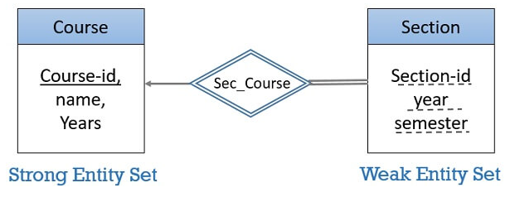
2. Weak Entity Sets-------
Now, the COURSE entity set has attributes {course_id, name, years}.
Here, the course_id is the primary key which distinguishes all the entities in the COURSE entity set.
Here, the primary key of the weak entity set SECTION is course_id + sec-id, year, semester.
The weak entity is shown by a rectangle in an ER diagram.
But, the attributes of weak entity set are underlined with the dashed line.
The relationship of a weak entity set and strong entity set is shown with the double diamond as shown in the figure above:

Slide 59
3.7. Associative Entities
An associative entity is a term used in relational and entity–relationship theory.
A relational database requires the implementation of a base relation (or base table) to resolve many-to-many relationships.
A base relation representing this kind of entity is called, informally, an associative table.
Associative entities are connections that describe a relationship between two different entities.
These entities can have many-to-many relationships, meaning that one of the associative entities may have multiple relationships and connections to a parent or child entity.

Slide 60
3.7. Associative Entities------
An associative entity is an entity type that associates the instances of one or more entity types and contains attributes that are peculiar to the relationship between those entity instances.
It’s an entity – it has attributes
AND it’s a relationship – it links entities together
When should a relationship with attributes be an associative entity?
All relationships for the associative entity should be many
The associative entity could have meaning independent of the other entities.
The associative entity should have at least one or more attributes other than the identifier.

Slide 61
3.7. Associative Entities-------
The associative entity may participate in other relationships other than the entities of the associated relationship.
Ternary relationships should be converted to associative entities.
The following figure in the next slide shows the relationship ‘Completes’ converted to an associative entity type
A CERTIFICATE is awarded to each EMPLOYEE who completes a COURSE, each certificate has a Certificate_Number that serves as the identifier

Slide 62
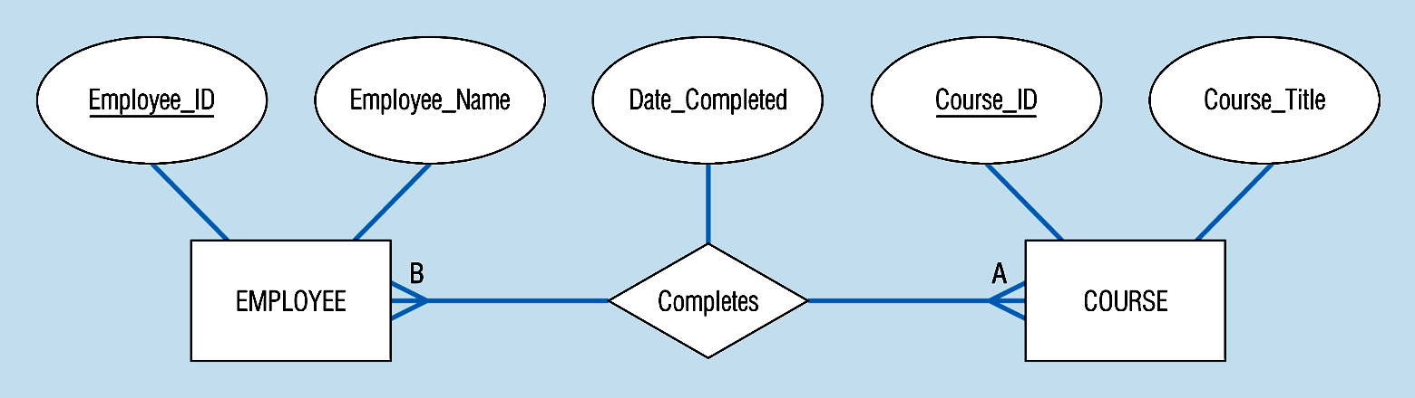
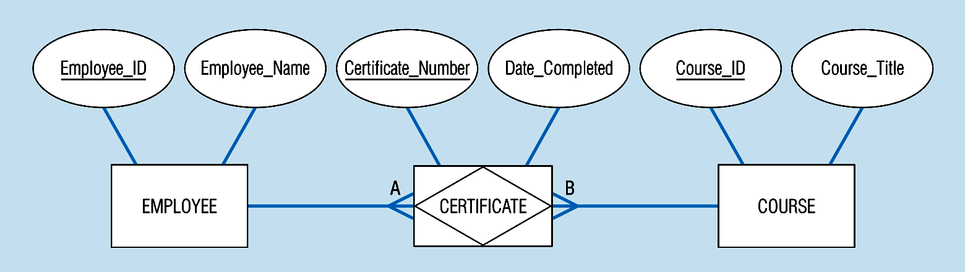
Figure 3-11b – An associative entity (CERTIFICATE)
Notes:
21

Slide 63
3.8. Enhanced E-R (EER) Models
Enhanced entity-relationship (EER) diagrams are basically a more expansive version of ER diagrams.
EER models are helpful tools for designing databases with high-level models.
With their enhanced features, you can plan databases more thoroughly by delving into the properties and constraints with greater precision
EER is a high-level data model that incorporates the extensions to the original ER model.
It is a diagrammatic technique for displaying the following concepts
Sub Class and Super Class
Specialization and Generalization
Union or Category
Aggregation

Slide 64
3.8.1 Features of EER Model
EER creates a design more accurate to database schemas.
It reflects the data properties and constraints more precisely.
It includes all modelling concepts of the ER model.
Diagrammatic technique helps for displaying the EER schema.
It includes the concept of specialization and generalization.
It is used to represent a collection of objects that is union of objects of different of different entity types.

Slide 65
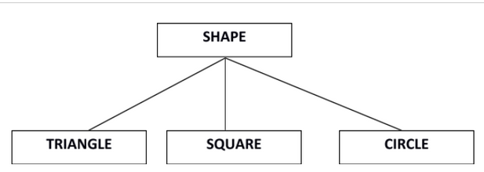
A. Subclasses and Super class
Super class is an entity that can be divided into further subtype.
For example − consider Shape super class.
Super class shape has sub groups: Triangle, Square and Circle.
Sub classes are the group of entities with some unique attributes.
Sub class inherits the properties and attributes from super class.

Slide 66
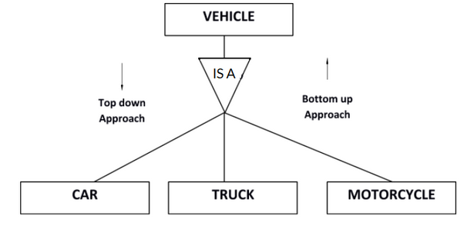
B. Specialization and Generalization
Generalization is a process of generalizing an entity which contains generalized attributes or properties of generalized entities.
It is a Bottom up process i.e. consider we have 3 sub entities Car, Truck and Motorcycle.

Slide 67
B. Specialization and Generalization
Now these three entities can be generalized into one super class named as Vehicle.
Specialization is a process of identifying subsets of an entity that share some different characteristic. It is a top down approach in which one entity is broken down into low level entity.
In above example Vehicle entity can be a Car, Truck or Motorcycle.

Slide 68
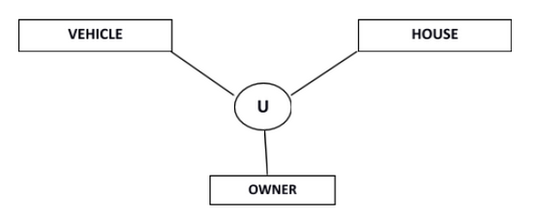
C. Category or Union
Relationship of one super or sub class with more than one super class.
Owner is the subset of two super class: Vehicle and House.

Slide 69
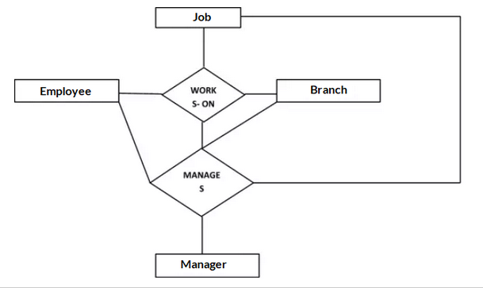
D. Aggregation
Represents relationship between a whole object and its component.
Consider a ternary relationship Works_On between Employee, Branch and Manager.
Now the best way to model this situation is to use aggregation, so, the relationship-set, Works_On is a higher level entity-set.
Such an entity-set is treated in the same manner as any other entity-set.
We can create a binary relationship, Manager, between Works_On and Manager to represent who manages what tasks.

Slide 70
Activity 2
1. Nahom Records has decided to store information about musicians who perform on its albums (as well as other company data) in a database. The company has wisely chosen to hire you as a database designer (at your usual consulting fee of 600Birr/day).
Each musician that records at Notown has an SSN, a name, an address, and a phone number.
Each instrument that is used in songs recorded at Nahom has a name (e.g., guitar,
synthesizer, flute)
Each album that is recorded on the Nahom label has a title, a copyright date, a format(e.g., CD , VCD, DVD), and an album identier.
Each song recorded at Nahom has a title and an author.
Each musician may play several instruments, and a given instrument may be played by several musicians.

Slide 71
Activity 2--------
Each album has a number of songs on it, but no song may appear on more than one album.
Each song is performed by one or more musicians, and a musician may perform a number of songs.
Each album has exactly one musician who acts as its producer. A musician may produce several albums, of course.
Design a conceptual schema for Nahom and draw an ER diagram for your schema.
Be sure to indicate all key and cardinality constraints and any assumptions that you make. Identify any constraints that you are unable to capture in the ER diagram and briefly explain why you could not express them.

Slide 72
Activity 2--------
2. The Prescriptions-R-X chain of pharmacies has offered to give you a free lifetime supply of medicines if you design its database. Here's the information that you gather:
Patients are identified by an SID, and their names, addresses, and ages must be recorded.
Doctors are identified by an EID. For each doctor, the name, specialty, and years of experience must be recorded.
Each pharmaceutical company is identified by name and has a phone number.
For each drug, the trade name and formula must be recorded. Each drug is sold by a given pharmaceutical company, and the trade name identified a drug uniquely from among the products of that company. If a pharmaceutical company is deleted, you need not keep track of its products any longer.
Each pharmacy has a name, address, and phone number.
Every patient has a primary physician. Every doctor has at least one patient.

Slide 73
Activity 2--------
Each pharmacy sells several drugs and has a price for each. A drug could be sold at several pharmacies, and the price could vary from one pharmacy to another.
Doctors prescribe drugs for patients. A doctor could prescribe one or more drugs for several patients, Each prescription has a date and a quantity associated with it.
Pharmaceutical companies have long-term contracts with pharmacies. A pharmaceutical company can contract with several pharmacies, and a pharmacy can contract with several pharmaceutical companies. For each contract, you have to store a start date, an end date, and the text of the contract.
Pharmacies appoint a supervisor for each contract. There must always be a supervisor for each contract, but the contract supervisor can change over the lifetime of the contract.
Draw an ER diagram that captures the above information.

Slide 74
Activity 2--------
3. Consider the following relations for a database that keeps track of student enrollment in courses and the books adopted for each course:
STUDENT(SSN, Name, Major, Bdate)
COURSE(Course#, Cname, Dept)
ENROLL(SSN, Course#, Quarter, Grade)
BOOK_ADOPTION(Course#, Quarter, Book_ISBN)
TEXT(Book_ISBN, Book_Title, Publisher, Author)
Draw a relational schema diagram specifying the foreign keys for this schema.

Slide 75
Key Terms
Alternate key: all candidate keys not chosen as the primary key
Candidate key: a simple or composite key that is unique (no two rows in a table may have the same value) and minimal (every column is necessary)
Characteristic entities: entities that provide more information about another table
Composite attributes: attributes that consist of a hierarchy of attributes
Composite key: composed of two or more attributes, but it must be minimal
Dependent entities: these entities depend on other tables for their meaning
Derived attributes: attributes that contain values calculated from other attributes
Derived entities: see dependent entities

Slide 76
Key Terms-------
Entity: a thing or object in the real world with an independent existence that can be differentiated from other objects
Entity Relationship (ER) dData Model: also called an ER schema, are represented by ER diagrams. These are well suited to data modelling for use with databases.
Entity set :a collection of entities of an entity type at a point of time
Entity Type: a collection of similar entities
Foreign Key (FK): an attribute in a table that references the primary key in another table OR it can be null
Independent Entity: as the building blocks of a database, these entities are what other tables are based on

Slide 77
Key Terms-----
Key: an attribute or group of attributes whose values can be used to uniquely identify an individual entity in an entity set
Multivalued attributes: attributes that have a set of values for each entity
n-ary: multiple tables in a relationship
null: a special symbol, independent of data type, which means either unknown or inapplicable; it does not mean zero or blank
Recursive relationship: see unary relationship
Relationships: the associations or interactions between entities; used to connect related information between tables
Relationship strength: based on how the primary key of a related entity is defined

Slide 78
Key Terms-----
Secondary key an attribute used strictly for retrieval purposes
Simple attributes: drawn from the atomic value domains
Single-valued attributes: see simple attributes
Stored attribute: saved physically to the database
Ternary relationship: a relationship type that involves many to many relationships between three tables.
Unary relationship: one in which a relationship exists between occurrences of the same entity set.

